Slide 1
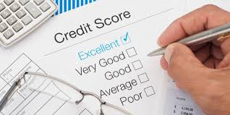
Credit EDA Case Study
Amrita Chatterjee and Padma A

Slide 2
Business Understanding

Slide 3
Business Objectives

Slide 4
Data Understanding

Slide 5
Data Cleaning

Slide 6
Data Manipulation

Slide 7
Handling Missing Values

Slide 8
Handling Outliers

Slide 9
Data Imbalance

Slide 10
Data Analysis

Slide 11
Univariate/Bivariate Analysis

Slide 12
Correlation for payment difficulties

Slide 13
Recommendations

